Slide 1
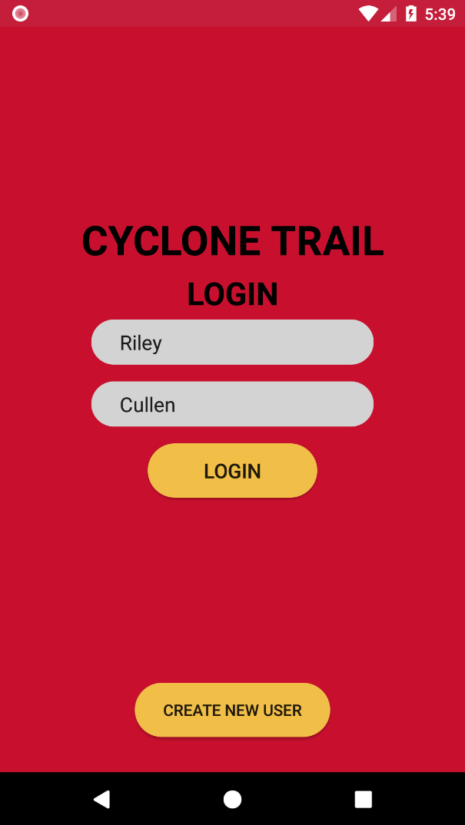
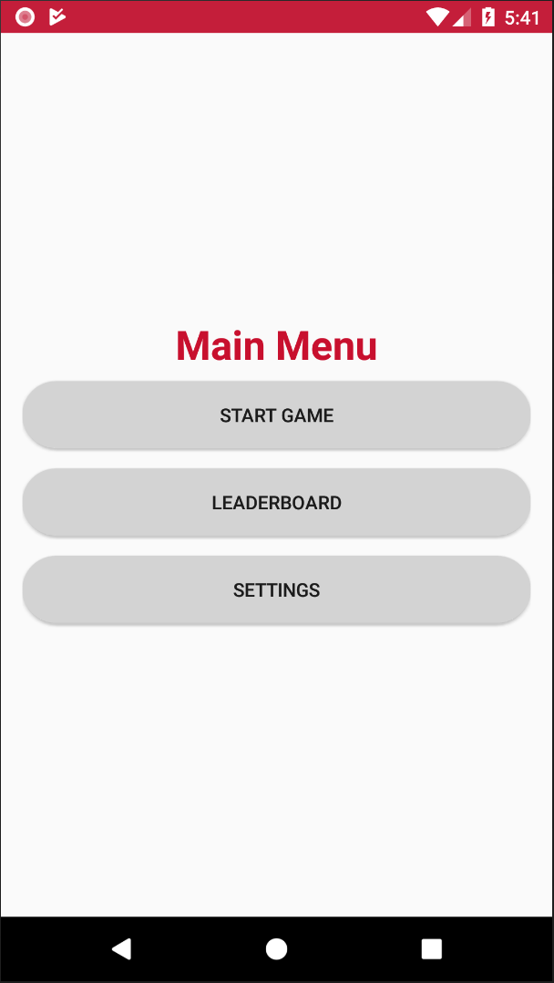
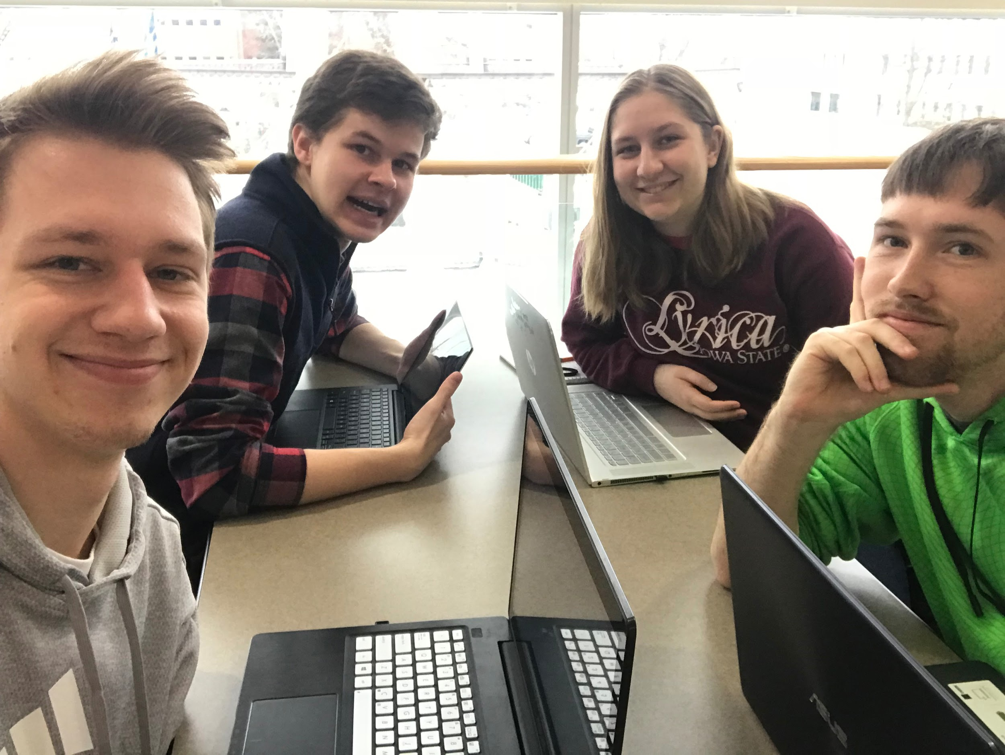
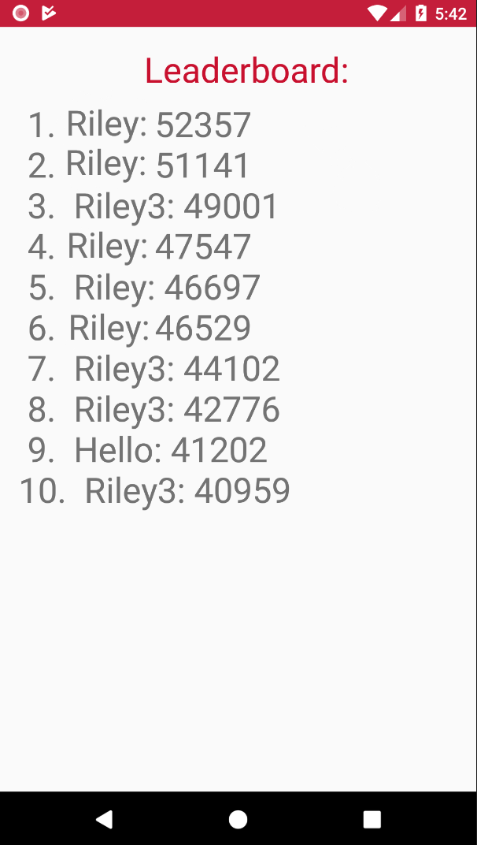
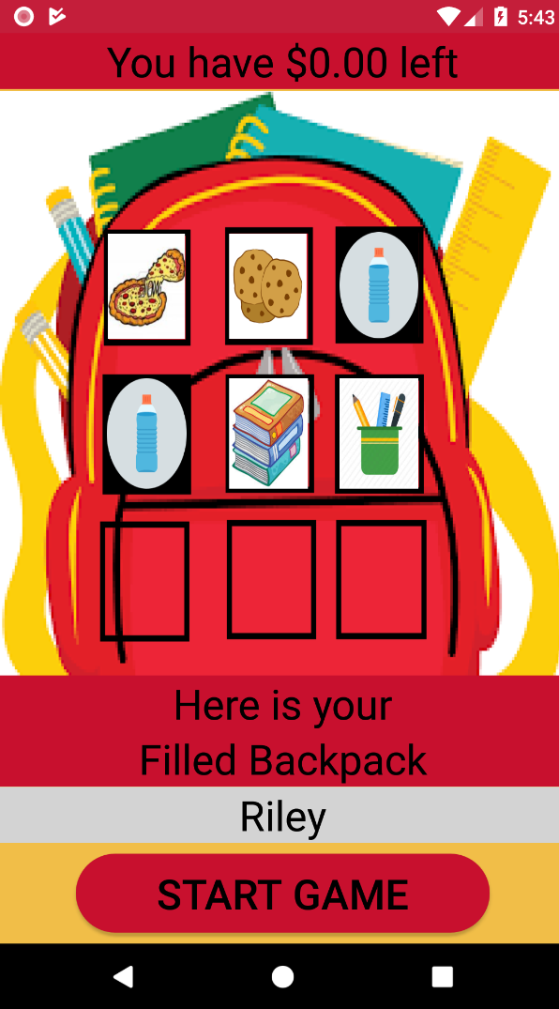
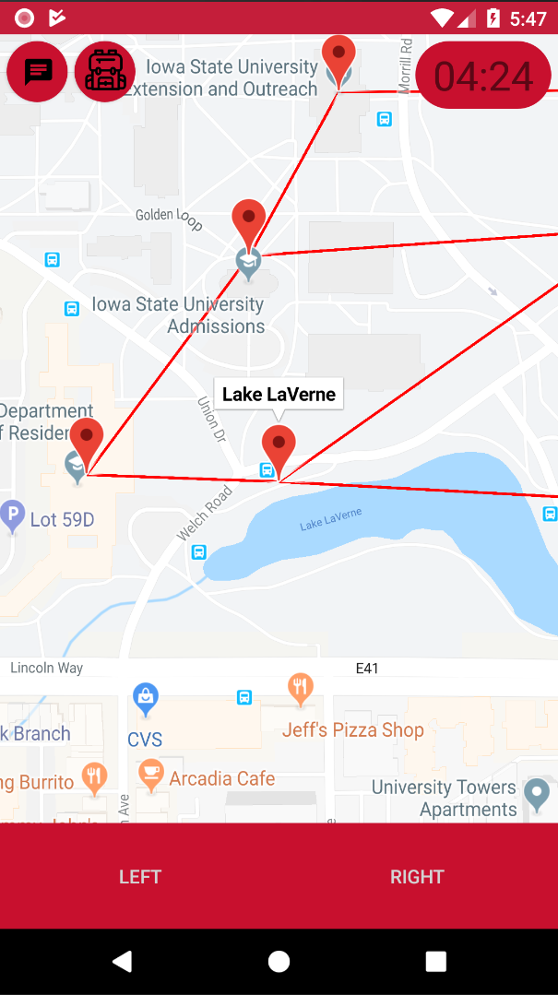
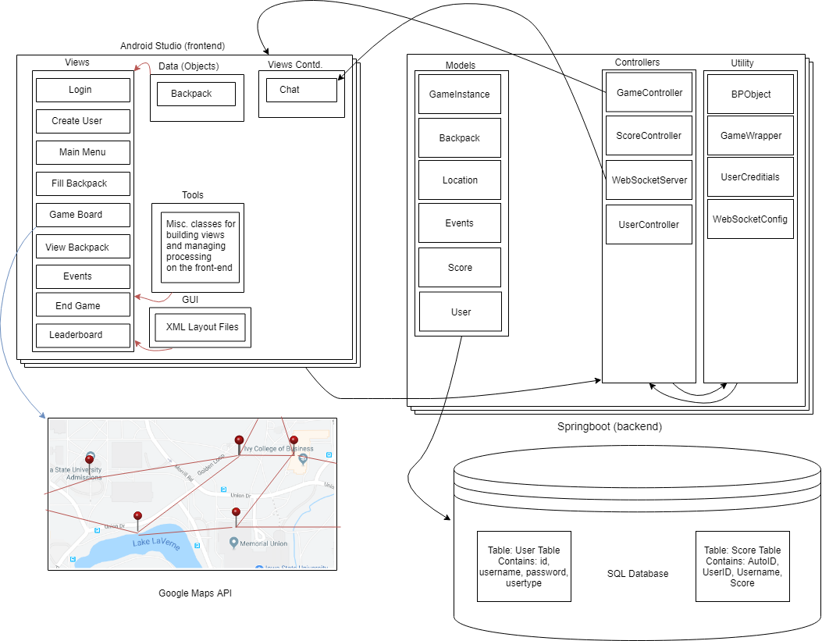
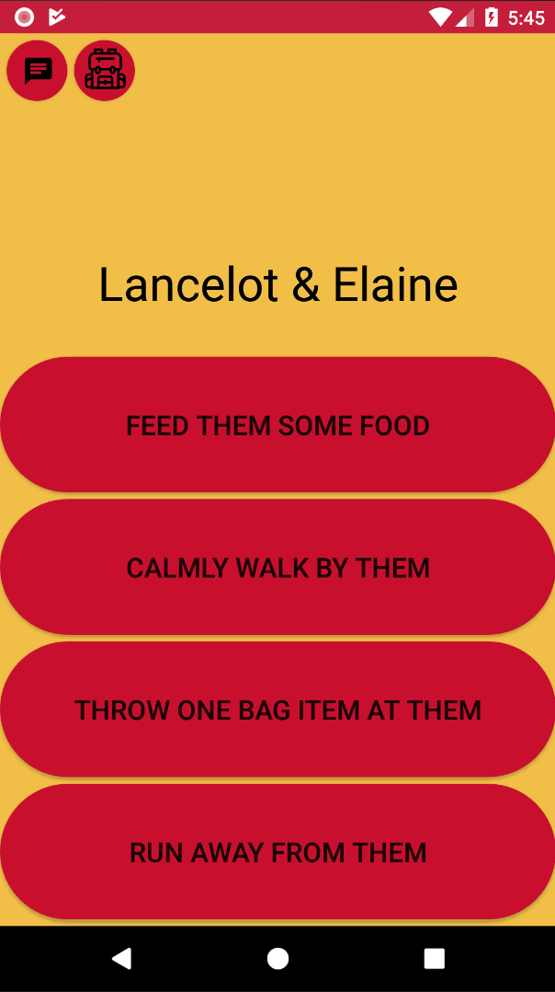
CYCLONE TRAIL
Ethan McGill (JR), Gabrielle Johnson(JR), Riley Cullen(SO), Riley Thoma(JR)
ComS 309, Spring 2016
Key Design Decisions:
We decided to use the Google Maps API to easily implement a modular map.
We decided to use MVC architecture in the backend to keep our code modular.
We use ISU colors to support our theme of the game being played on Iowa State campus.
We decided to store a “GameInstance” object in the backend application to access the users information while they were in the game quickly, so the client was not slowed down by SQL Queries. This also made the game playable by multiple users at once.
Actors: Standard Player & Admin
Project Description:
In this wacky, wild, and amazing android game you play the role of an engineering student at Iowa State University!!! HOW EXCITING! It’s your first day of classes and you just woke up 5 minutes before your first lecture 😕 OH NO! Time to grab some of those books and groceries you bought last night, throw them in your backpack, and trek across central campus to Troxel Hall. However, be wary traveller, as many creatures and life happenstances attempt to thwart your timeliness in this epic odyssey of being late to class at Iowa State University.
To Chat To Backpack
Game Clock
Module interfaces descriptions:
Login Screen:
From this Screen, the player can create an account using a unique username and password that isn’t already taken, as well as logging into their own account once they have credentials.
Main Menu:
From this Screen, the player can either start a new game, view the leaderboard screen, or view settings.
Leaderboard:
This screen displays the top 10 scores of all attempts to cross the Cyclone Trail.
Fill Backpack Screen:
This screen displays that the user has $10 to spend before embarking upon the Cyclone Trail, which they may use to purchase food, water and school supplies to fill their 9 backpack slots.
Game Board Screen:
This screen displays a google maps activity with nodes and polylines connecting important locations in the game. There exists buttons for the chat menu, the ability to view the contents of your backpack, and moving along the left or rightmost polylines towards your next destination. There’s also a timer in the top left which shows you how much time is left until you’re late to class!
Event Screen:
Each event has a title and four choices to interact with it. Depending on your choice you may receive or lose objects such as food, water, school supplies or time itself! 😮😯😱 From the event screen you may also view the chat menu and view the contents of your backpack.
Teamwork/Project Lessons Learnt:
Things that went right:
We used Google APIs to reflect where locations are on campus
There is proper verification for returning users
Have a working application that is playable for others
Things that went wrong:
Application crashes in some use cases
To play a new game, a user has to exit the app completely
Didn’t get all features implemented
Lessons Learned:
How to develop with a frontend, backend, and database
How to property budget time within a group project
How to coordinate amount of work between the frontend and backend groups
Use Cases | Descriptions
UC-1: User creates login | As a user I would like to create and user and login.
UC-2: User looks at leaderboard | As a user I would like to look at the top ten high scores from the main menu and end game screen.
UC-3: User fills backpack | As a user I would like to buy items and put them into my backpack before embarking on the trail.
UC-4: User navigates on the game board | As a user I would like to see my users icon moving across the map to each location.
UC-5: User triggers events throughout the game | As a user I would like events to trigger when I reach different locations in the game.
BLOCK DIAGRAM
Event Screen

